Slide 1

Surprise
Useful Expressions
Really!
Are you serious?
For real!
You’re kidding/ You’re joking!
No way!

Slide 3
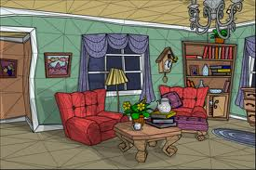
There is / There are
What’s in the living room?
In the living room, there is a table.
In the living room there are chairs.
In the living room there are many books.

Slide 4
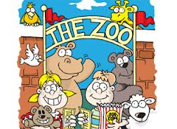
There is / There are
What is in the zoo?
In the zoo, there are animals
In the zoo there is a lion.

Slide 5
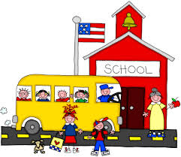
There is / There are
What is in the school?
In the school, there are children.
In the school there is a teacher.

Slide 6
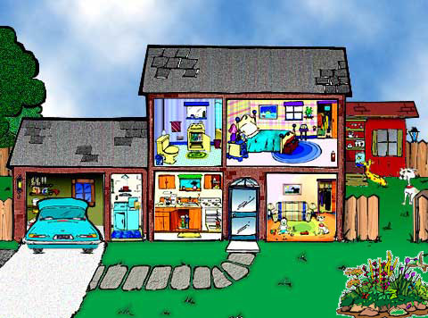

Slide 7
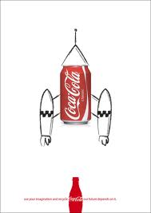
What is an AD?

